Slide 1
Machine Learning Techniques
Support Vector Machine
Instructor: Najam Aziz

Slide 2
Support Vector Machines

Slide 3
Support Vector Machine (SVM)
supervised and linear Machine Learning algorithm
There is also a subset of SVM called SVR which stands for Support Vector Regression which uses the same principles to solve regression problems. SVM also supports the kernel method also called the kernel SVM which allows us to tackle non-linearity.
The objective of SVM is to draw a line that best separates the two classes of data points.
SVM generates a line that can cleanly separate the two classes. How clean, you may ask. There are many possible ways of drawing a line that separates the two classes, however, in SVM, it is determined by the margins and the support vectors.
SVM generates optimal hyperplane in an iterative manner, which is used to minimize an error.

Slide 4
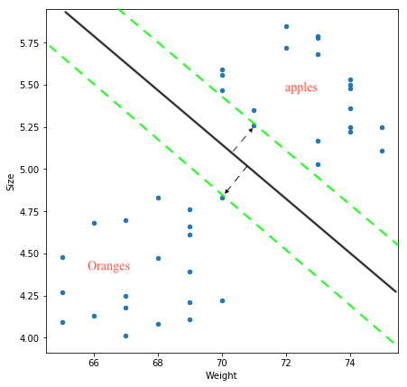
The margin is the area separating the two dotted green lines as shown in the image above. The more the margin the better the classes are separated.
The support vectors are the data points through which each of the green lines passes through.
These points are called support vectors as they contribute to the margins and hence the classifier itself. These support vectors are simply the data points lying closest to the border of either of the classes which has a probability of being in either one.
The SVM then generates a hyperplane which has the maximum margin, in this case the black bold line that separates the two classes which is at an optimum distance between both the classes.
In case of more than 2 features and multiple dimensions, the line is replaced by a hyperplane that separates multidimensional spaces.

Slide 5
Use Case: what Kind of problem it can solve?
Regression Problems (SVR)
predict the salary of an employee given a few independent variables.
Classification Problems (SVM)
handwriting recognition, intrusion detection, face detection, email classification, gene classification
Outliers Detection
- Can handle both classification and regression on linear and non-linear data. But generally use for classification problems
Notes:
SVR- support vector regression
Hyperplane in SVR is the line that will be used to predict the continuous output.

Slide 6
Application of SVM in real life
Face detection
Image classification
Reorganization of Handwriting
Geo and environmental sciences
Bioinformatics
Text categorization
Protein fold and remote homology detection
Generalized predictive control

Slide 7
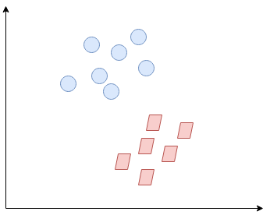
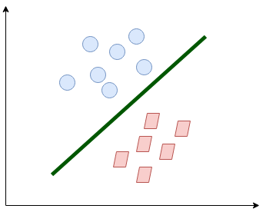
What exactly SVM does?
Find a line/hyperplane (in multidimensional space) that separates these two classes. Then it classifies the new point depending on whether it lies on the positive or negative side of the hyperplane depending on the classes to predict.

Slide 8
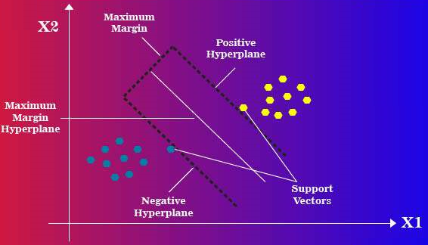
Basic Concepts
Support Vector
Hyperplane
Margin Distance
Linear Separable
Non-Linear Separable
Notes:
Support Vectors: Data points nearest to the hyperplane, the points of a data set that, if removed, would alter the position of the dividing hyperplane. Because of this, they can be considered the critical elements of a data set.
In logistic regression we also create a hyperplane/line(in 2D). But the main difference between Logistic Regression and SVM is Margin Distance

Slide 9
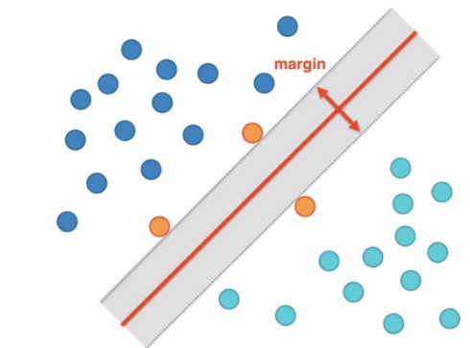
Notes:
Optimized model will have larger margin. But it depends on situation sometime we need smaller margin and sometime we need larger margin.

Slide 10
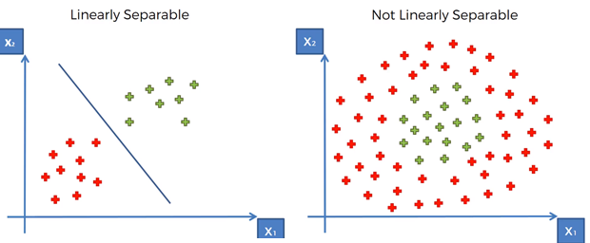
Linear vs Non-Linear Separable
Linear: Separated by straight line or plane
Non-Linear: Can’t separate by a straight line
Notes:
In Non-Linear data, we use SVM kernel Technique
SVM kernel transforms low dimensional data(e.g. 2D) into high dimension(e.g. 3D)

Slide 11
Types of SVM
SVM can be of two types:
Linear SVM: SVM used for linearly separable data
which means if a dataset can be classified into two classes by using a single straight line, then such data is termed as linearly separable data, and classifier is used called as Linear SVM classifier.
Non-linear SVM: SVM used for non-linearly separated data
which means if a dataset cannot be classified by using a straight line, then such data is termed as non-linear data and classifier used is called as Non-linear SVM classifier.

Slide 12
SVM Hyperparameter
Kernel: transform the given dataset input data into the required form.
Linear, RBF, Poly(default value is “rbf”). “rbf” and “poly” are useful for non-linear hyper-plane.
Go for linear SVM kernel if you have a large number of features (>1000) because it is more likely that the data is linearly separable in high dimensional space.
Gamma: Used with Non-linear SVM, Range 0 -1
Kernel coefficient for ‘rbf’, ‘poly’ and ‘sigmoid’.
Higher the value of gamma, will try to exact fit as per training data set i.e. generalization error and cause over-fitting problem.
Gamma=0.1 is considered to be a good default value. The value of gamma needs to be manually specified in the learning algorithm.
C: SVM regularization parameter-
Controls the trade-off between smooth decision boundaries and classifying the training points correctly.
The Regularization parameter (often termed as C parameter in python's sklearn library) tells the SVM optimization how much you want to avoid misclassifying each training example
Notes:
C: control tradeoff between large marginal distance(decision boundary) and misclassifcation
Gamma: How far the influence of single training example reach. Low value mean Far, High value means Close

Slide 13
SVM Kernels
The SVM algorithm is implemented in practice using a kernel. A kernel transforms an input data space into the required form. SVM uses a technique called the kernel trick. Here, the kernel takes a low-dimensional input space and transforms it into a higher dimensional space. In other words, you can say that it converts nonseparable problem to separable problems by adding more dimension to it. It is most useful in non-linear separation problem. Kernel trick helps you to build a more accurate classifier.

Slide 14
Multiclass Classification Using SVM
SVM were originally designed to only support two-class-problems.
SVM doesn't support multiclass classification. For multiclass classification, the same principle is utilized after breaking down the multi-classification problem into smaller subproblems, all of which are binary classification problems.
The popular methods which are used to perform multi-classification on the problem statements using SVM are as follows:
One vs One (OVO) approach
One vs All (OVA) approach
Directed Acyclic Graph (DAG) approach

Slide 15
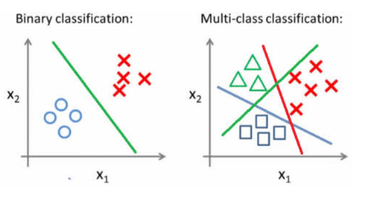
Binary vs Multiclass Classification

Slide 16
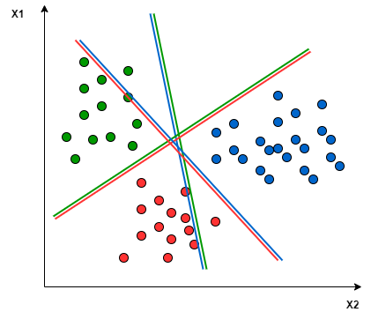
One vs One (OVO) approach
In the One-to-One approach, we try to find the hyperplane that separates between every two classes, neglecting the points of the third class.
The major problem with this approach is that we have to train too many SVMs.
Each binary classifier predicts one class label. Classification decision is based on majority voting
Notes:
OVO classification decision: Each binary classifier predicts one class label. When we input the test data to the classifier, then the model with the majority counts is concluded as a result.

Slide 17
One vs All (OVA)
In this technique, if we have N class problem, then we learn N SVMs:
SVM number -1 learns “class_output = 1” vs “class_output ≠ 1″
SVM number -2 learns “class_output = 2” vs “class_output ≠ 2″
:
SVM number -N learns “class_output = N” vs “class_output ≠ N”
Classification decision is based on the probability of the new data sample belonging to a specific class
Notes:
Incase of imbalance dataset, we often check f1-score instead of accuracy score. If dataset is in perfect balance such as Iris dataset, we check accuracy score of the model.

Slide 18
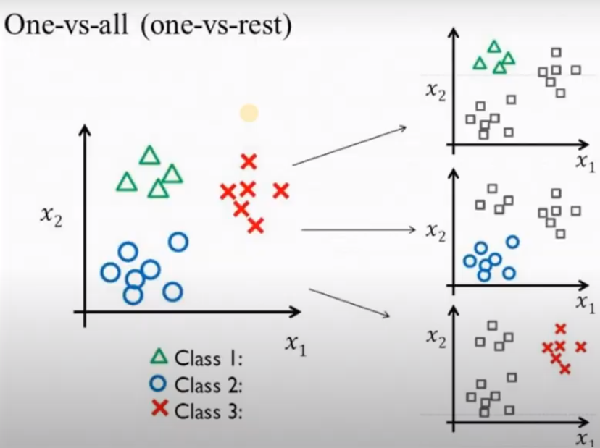

Slide 19
Challenges with SVM Multiclass classification
Yes, there are some challenges to train these N SVMs, which are:
1. Too much Computation: To implement the OVA strategy, we require more training points which increases our computation.
2. N-class instances then
One vs. One: N* (N-1)/2 binary classifier models
One vs. All: N binary classifier models
3. Problems becomes Unbalanced: Let’s you are working on an MNIST dataset, in which there are 10 classes from 0 to 9 and if we have 1000 points per class, then for any one of the SVM having two classes, one class will have 9000 points and other will have only 1000 data points, so our problem becomes unbalanced.

Slide 20
SVM Pros & Cons
Pros:
It works really well with a clear margin of separation
It is effective in high dimensional spaces.
It is effective in cases where the number of dimensions/features is greater than the number of samples. Works better on smaller and complex dataset (large features and lesser training data)
Cons:
It doesn’t perform well when we have large data set(more samples, less features) because the required training time is higher
It also doesn’t perform very well, when the data set has more noise i.e. target classes are overlapping
Notes:
Target classes overlapping: where features similar but thy have different classes. So it becomes difficult to classify.

Slide 21
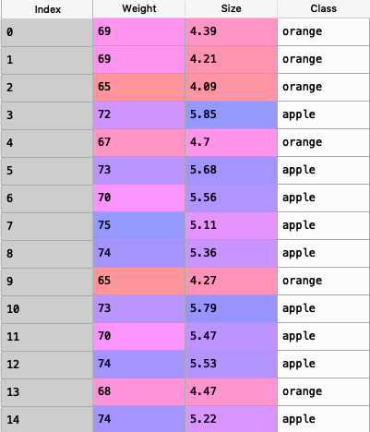
Implementation in Python
import pandas as pd
data = pd.read_csv("apples_and_oranges.csv”)

Slide 22
Splitting the dataset into training and test samples
from sklearn.model_selection import train_test_split
training_set, test_set = train_test_split(data, test_size = 0.2, random_state = 1)
Classifying the predictors and target
X_train = training_set.iloc[:,0:2].values
Y_train = training_set.iloc[:,2].values
X_test = test_set.iloc[:,0:2].values
Y_test = test_set.iloc[:,2].values
Initializing Support Vector Machine and fitting the training data
from sklearn.svm import SVC
classifier = SVC(kernel='rbf', random_state = 1) ##clf = svm.SVC(kernel='linear') # Linear Kernel
classifier.fit(X_train,Y_train)

Slide 23
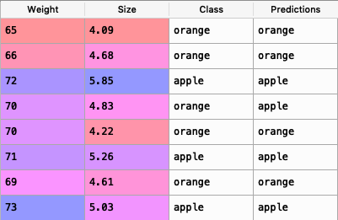
Predicting the classes for test set
Y_pred = classifier.predict(X_test)
Attaching the predictions to test set for comparing
test_set["Predictions"] = Y_pred
Comparing the actual classes and predictions

Slide 24
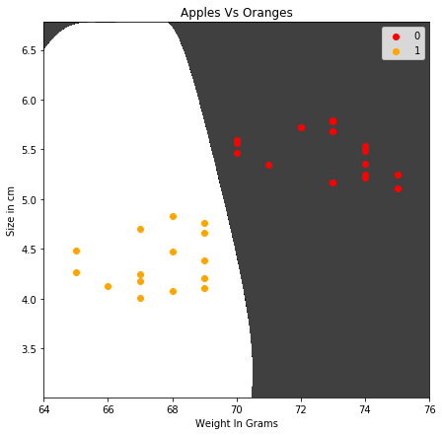
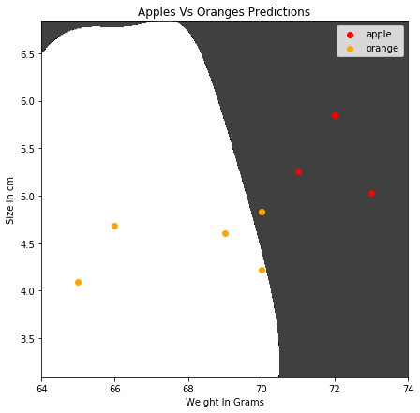
Visualization of Training and Test Data
Training
Testing
Notes:
In case of blue, as we have only two classes and there is no scenior of majority voting. So in this case, the blue dot will be unclassified

Slide 25


